Slide 1
Recurrent nets
Bryan Pardo
Deep Learning
Northwestern University
Deep Learning: Bryan Pardo, Northwestern University, Fall 2020

Slide 2
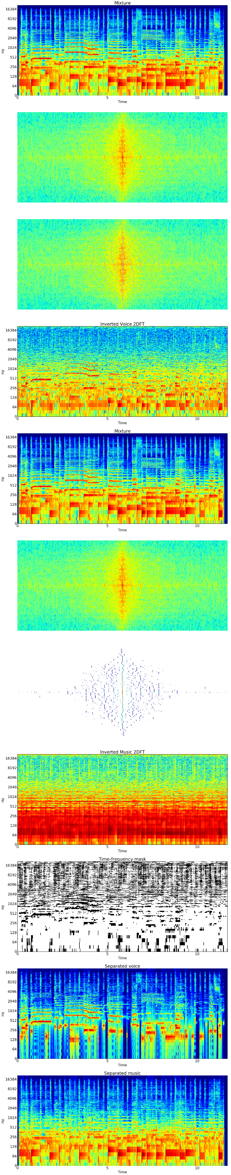
Dealing with time
With a ”standard” feed-forward architecture, you process data from within a window, ignoring everything outside the window.
To get influence from the processing of earlier time steps, add nodes and connections
This doesn’t scale well
t-2
t-1
t
output

Slide 3
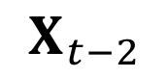
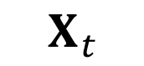
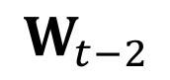
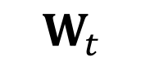
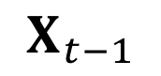
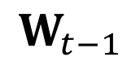
Let’s look at that net.
An entire new set of weights for EACH time step.
Audio is sampled at 44,100 times per second
The number of past time steps you could consider is limited by the architecture.
The number of weights to learn quickly gets out of control.
t-2
t-1
t
$$W_{t−2}$$
$$W_{t−1}$$
$$W_{t}$$
$$X_{t−2}$$
$$X_{t−1}$$
$$X_{t}$$

Slide 4
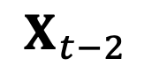



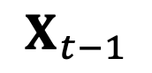
Take an idea from CNNs and HMMs
Markov property: The state of the world can be captured by knowing current state + immediately previous state
Markov models use recurrent connections
CNNs use the same set of shared weights on different parts of the input
Shared
weights
$$W$$
$$W$$
$$W$$
Distinct
inputs
$$X_{t−2}$$
$$X_{t−1}$$
$$X_{t}$$

Slide 5
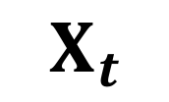

Take an idea from CNNs and HMMs
Current output
If all the windows share the same input weights (like in a feature map), then we only have the same number of weights as if we had a single window.
This is a recurrent net.
How do you train this?
Are there any obvious limitations?
Out from t-1
In to t+1
$$W$$
$$X_{t}$$

Slide 6
Backprop through time: “Unrolling”
Pick a number of steps over which you’re going to “unroll” the net.
Treat it like you’re training a convolutional neural net
Pick the number of steps based on your frenemy: Exponential decay

Slide 7
Getting influence from the past: Skip connections (used in Highway networks)
Widely used
Limited by the length of the skip

Slide 8
Exponentially decaying influence
If your network needs to connect information from a distant timestep, the influence of the earlier one tends to get lost
Why? Exponential decay.

Slide 9
Exploding and vanishing gradients
What if the weight on the recurrent connection is greater than 1?
What if the weight on the recurrent link is less than 1?
What if it is exactly 1?
Recurrent
connection
$$W$$
$$X_{t}$$

Slide 10
An RNN example: Language modeling
In language modeling, the game is to be able to predict the next word, given the previous N words.
Examples
“Two plus two equals…”
“A stitch in time saves….”
“I never did…”

Slide 11
Our text encoding
1000 most common English words. + start + stop + other
Encoding: 1003 element one-hot vector for each word in a sentence
Word index determined by popularity
Start = 1001
Stop = 1002
Other (any word not in the top 1000) = 1003
Examples:
An apple is good for you. -> [1001, 48, 927, 121, 7, 26, 1002]
Lilliputian dilatants prognosticate parsimoniously! -> [1001, 1003, 1003, 1003, 1003, 1002]

Slide 12
The goal: predict the next token
Each sentence is its own label.
Given “An apple is…”, predict “good” as the next word.
Our model output will be a probability distribution over the 1003 element vector (top 1000 words + start + stop + other).
We can use cross-entropy loss, comparing the one-hot vector to the probability vector output by the model.

Slide 13
Our network
Argmax output
fruit
is
good
Probability distribution
over words
4-node RNN
Hidden layer
INPUT:
An apple is good for you
t-2 t-1 t

Slide 14
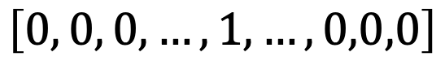
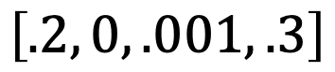
A RNN with 4 hidden nodes : how many weights?
OUTPUT a 1003 element probability distribution over the set of words.
Output layer
$$\left[0.01, .0000098,…,.0023, …,.001,0,.000053\right]$$
Softmax activation
ALL HIDDEN NODES ARE FULLY CONNECTED TO THE OUTPUT LAYER
Hidden layer
Sigmoid activation
ALL HIDDEN NODES ARE FULLY CONNECTED TO THE INPUT LAYER
Input +
prev state
$$\left[0, 0, 0,…,1, …,0,0,0\right]$$
$$\left[.2, 0, .001, .3\right]$$
INPUT word w(t): a 1003 element
one-hot vector encoding word t.
Previous state s(t-1): a vector of the output
from each hidden unit from time t-1
Notes:
4 hidden nodes * (1003 input vector size + output from 4 hidden notes from prev timestep) = 4*1007= 4028
4 hidden nodes * 1003 output vector size (so there have to be 1003 nodes in the output) = 4*1003 = 4012

Slide 15
What if we use a more realistically sized net?
Dictionary size = 50,000
Hidden states = 100
50,000*100*2 = 10,000,000
It’s just that easy to have 10 million weights.
Adding a couple of extra hidden layers (even fully connected ones) doesn’t cost you much, compared to the dictionary size.

Slide 16
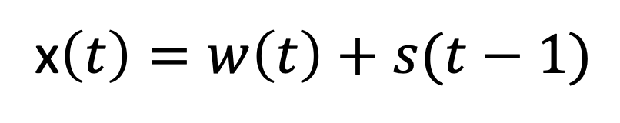
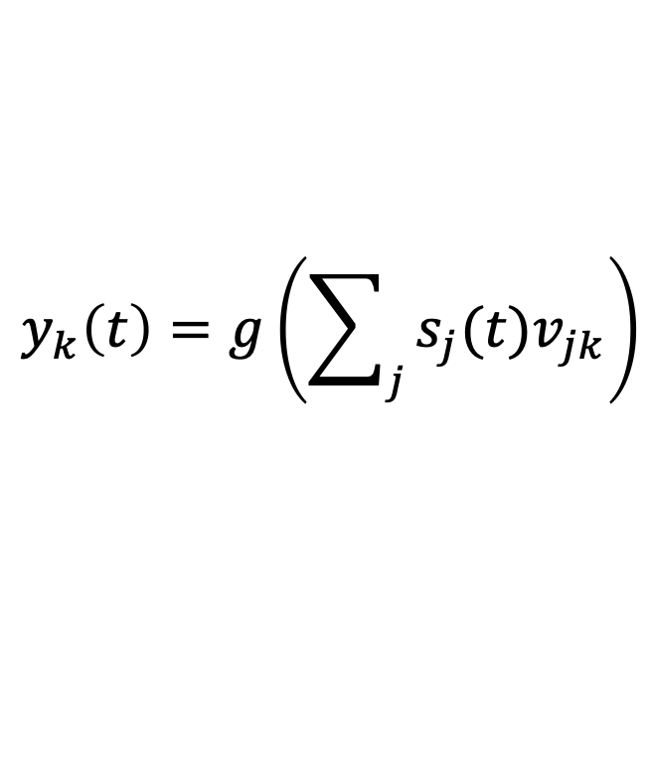
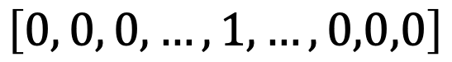
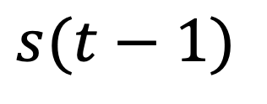
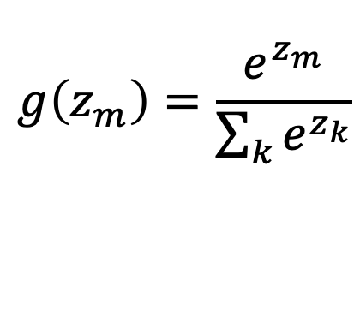
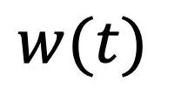
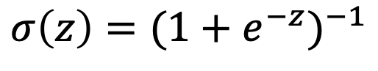
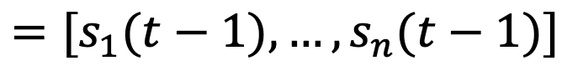
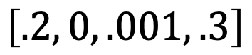
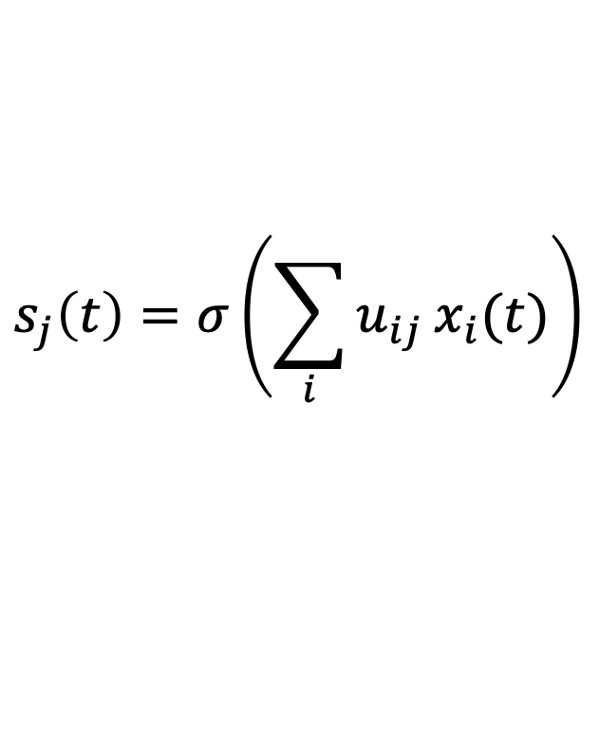
RNN: the math
OUTPUT a 1003 element probability distribution over the set of words.
$$y_{k}\left(t\right)=g\left(\sum_{j}{s_{j}(t)v_{jk}}\right)$$
$$g\left(z_{m}\right)=\frac{e^{z_{m}}}{\sum_{k}{e^{z_{k}}}}$$
Output layer
$$\left[0.01, .0000098,…,.0023, …,.001,0,.000053\right]$$
Softmax activation
ALL HIDDEN NODES ARE FULLY CONNECTED TO THE OUTPUT LAYER
$$s_{j}\left(t\right)=σ\left(\sum_{i}{u_{ij}}x_{i}(t)\right)$$
$$σ\left(z\right)={(1+e^{−z})}^{−1}$$
Hidden layer
Sigmoid activation
x$\left(t\right)=w\left(t\right)+s(t−1)$
ALL HIDDEN NODES ARE FULLY CONNECTED TO THE INPUT LAYER
$$w(t)$$
$$s(t−1)$$
Input +
prev state
$$\left[0, 0, 0,…,1, …,0,0,0\right]$$
$$\left[.2, 0, .001, .3\right]$$
$$=[s_{1}(t−1),…,s_{n}(t−1)]$$
INPUT word w(t): a 1003 element
one-hot vector encoding word t.
Previous state s(t-1): a vector of the output
from each hidden unit from time t-1
Concatenation
Notes:
4 hidden nodes * (1003 input vector size + output from 4 hidden notes from prev timestep) = 4*1007= 4028
4 hidden nodes * 1003 output vector size (so there have to be 1003 nodes in the output) = 4*1003 = 4012

Slide 17
RNN: the math
OUTPUT a 1003 element probability distribution over the set of words.
$$y_{k}\left(t\right)=g\left(\sum_{j}{s_{j}(t)v_{jk}}\right)$$
$$g\left(z_{m}\right)=\frac{e^{z_{m}}}{\sum_{k}{e^{z_{k}}}}$$
Output layer
$$s_{j}\left(t\right)=σ\left(\sum_{i}{u_{ij}}x_{i}(t)\right)$$
Hidden layer
$$σ\left(z\right)={(1+e^{−z})}^{−1}$$
x$\left(t\right)=w\left(t\right)+s(t−1)$
$$w(t)$$
$$s(t−1)$$
$$=[s_{1}(t−1),…,s_{n}(t−1)]$$
Input +
prev state
INPUT word w(t): a 1003 element
one-hot vector encoding word t.
Notes:
4 hidden nodes * (1003 input vector size + output from 4 hidden notes from prev timestep) = 4*1007= 4028
4 hidden nodes * 1003 output vector size (so there have to be 1003 nodes in the output) = 4*1003 = 4012

Slide 18
RNN: making a prediction
$$prediction=\hat{w}(t+1)=\underset{k}{argmax}{{[y}_{1}\left(t\right)\text{,…,}y_{k}\left(t\right)\text{,…,}y_{m}\left(t\right)\text{]}}$$
$$y_{k}\left(t\right)=g\left(\sum_{j}{s_{j}(t)v_{jk}}\right)$$
$$g\left(z_{m}\right)=\frac{e^{z_{m}}}{\sum_{k}{e^{z_{k}}}}$$
Output layer
$$s_{j}\left(t\right)=σ\left(\sum_{i}{u_{ij}}x_{i}(t)\right)$$
Hidden layer
$$σ\left(z\right)={(1+e^{−z})}^{−1}$$
x$\left(t\right)=w\left(t\right)+s(t−1)$
$$w(t)$$
$$s(t−1)$$
$$=[s_{1}(t−1),…,s_{n}(t−1)]$$
Input +
prev state
INPUT word w(t): a 1003 element
one-hot vector encoding word t.
Recurrent neural network-based language model (Interspeech 2010)
Notes:
4 hidden nodes * (1003 input vector size + output from 4 hidden notes from prev timestep) = 4*1007= 4028
4 hidden nodes * 1003 output vector size (so there have to be 1003 nodes in the output) = 4*1003 = 4012

Slide 19
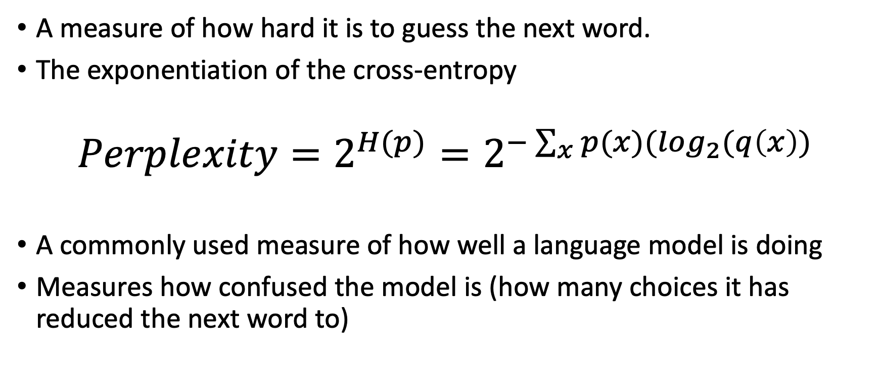
Perplexity
A measure of how hard it is to guess the next word.
The exponentiation of the cross-entropy
$$Perplexity=2^{H(p)}=2^{−\sum_{x}{p(x)(\log_{2}⁡(q\left(x\right))}}$$
A commonly used measure of how well a language model is doing
Measures how confused the model is (how many choices it has reduced the next word to)

Slide 20
A language model is a generative model
If you have something that predicts the next word, you have something that can “generate” the next word.
Sentence completion is possible
Sentence generation is possible

Slide 21
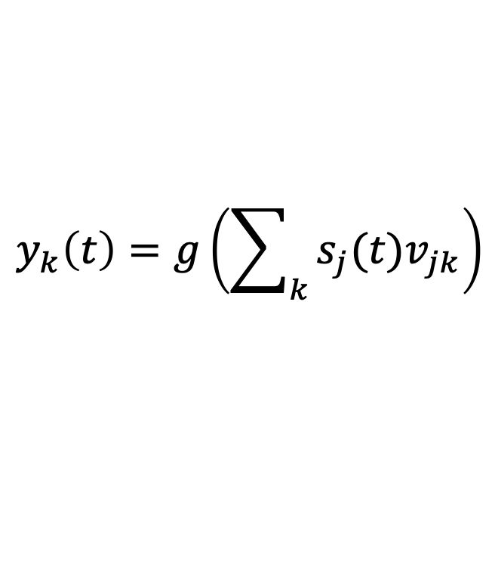
Language model as a generative model:
$$generation=\hat{w}\left(t+1\right)=sample from:{{[y}_{1}\left(t\right)\text{,…,}y_{k}\left(t\right)\text{,…,}y_{m}\left(t\right)\text{]}}$$
$$y_{k}\left(t\right)=g\left(\sum_{k}{s_{j}(t)v_{jk}}\right)$$
$$g\left(z_{m}\right)=\frac{e^{z_{m}}}{\sum_{k}{e^{z_{k}}}}$$
Output layer
$$s_{j}\left(t\right)=σ\left(\sum_{i}{u_{ij}}x_{i}(t)\right)$$
Hidden layer
$$σ\left(z\right)={(1+e^{−z})}^{−1}$$
x$\left(t\right)=w\left(t\right)+s(t−1)$
$$w(t)$$
$$s(t−1)$$
$$=[s_{1}(t−1),…,s_{n}(t−1)]$$
Input +
prev state
INPUT word w(t): a 1003 element
one-hot vector encoding word t.
Recurrent neural network-based language model (Interspeech 2010)
Notes:
4 hidden nodes * (1003 input vector size + output from 4 hidden notes from prev timestep) = 4*1007= 4028
4 hidden nodes * 1003 output vector size (so there have to be 1003 nodes in the output) = 4*1003 = 4012

Slide 22
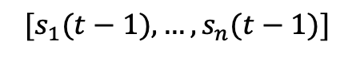
Generating a new sentence with the model
She
Sample from the conditional
distribution output by the model
Random initialization
$$[s_{1}(t−1),…,s_{n}(t−1)]$$
Pick an initialization token
START

Slide 23
Generating a new sentence with the model
She
likes
Sample from the conditional
distribution output by the model
Random initialization
$$[s_{1}(t−1),…,s_{n}(t−1)]$$
START She
from model output at previous time step

Slide 24
Generating a new sentence with the model
She
likes
cheese
Sample from the conditional
distribution output by the model
Random initialization
$$[s_{1}(t−1),…,s_{n}(t−1)]$$
START She likes

Slide 25
Generating a new sentence with the model
Continue till you generate a stop token
She
likes
cheese
STOP
Sample from the conditional
distribution output by the model
Random initialization
$$[s_{1}(t−1),…,s_{n}(t−1)]$$
START She likes cheese

Slide 26
Getting more context
We predict/generate a new token, based on a prior sequence.
Our generated output is contextually informed by the past
But wait….if our training data is whole sentences, can’t we do the same thing from the ”future” (i.e. the next word or rest of sentence)?
Sure we can. Just feed in the sequence backwards.

Slide 27
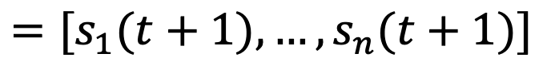
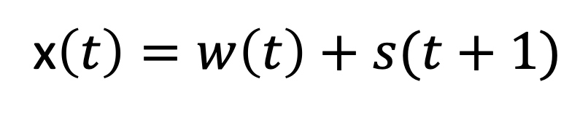
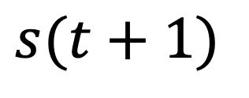
RNN: predicting the “past” based on the “future”
$$prediction=\hat{w}(t−1)=\max_{k}{{[y}_{1}\left(t\right)\text{,…,}y_{k}\left(t\right)\text{,…,}y_{m}\left(t\right)\text{]}}$$
$$y_{k}\left(t\right)=g\left(\sum_{k}{s_{j}(t)v_{jk}}\right)$$
$$g\left(z_{m}\right)=\frac{e^{z_{m}}}{\sum_{k}{e^{z_{k}}}}$$
Output layer
$$s_{j}\left(t\right)=σ\left(\sum_{i}{u_{ij}}x_{i}(t)\right)$$
Hidden layer
$$σ\left(z\right)={(1+e^{−z})}^{−1}$$
x$\left(t\right)=w\left(t\right)+s(t+1)$
$$w(t)$$
$$s(t+1)$$
$$=[s_{1}(t+1),…,s_{n}(t+1)]$$
Input +
next state
INPUT word w(t): a 1003 element
one-hot vector encoding word t.
Notes:
4 hidden nodes * (1003 input vector size + output from 4 hidden notes from prev timestep) = 4*1007= 4028
4 hidden nodes * 1003 output vector size (so there have to be 1003 nodes in the output) = 4*1003 = 4012

Slide 28
Bidirectional RNN
Inform output layer’s probability distribution using a forward layer and a backwards layer
The generated token(s) are influenced by both previous and subsequent context
OUTPUT:
good
INPUT:
An apple is - for you

Slide 29
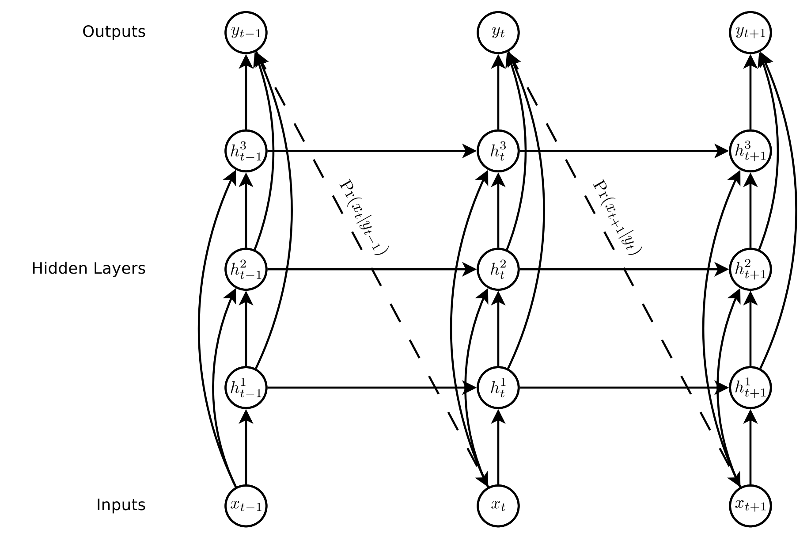
Multi-layer RNN
You can have multiple hidden layers, where layer n feeds into layer n+1
Image from Graves, Alex. "Generating sequences with recurrent neural networks." arXiv preprint arXiv:1308.0850 (2013).

Slide 30
Long-Short Term Memories
Hochreiter, Sepp, and Jürgen Schmidhuber. "Long short-term memory." Neural computation 9.8 (1997): 1735-1780.

Slide 31
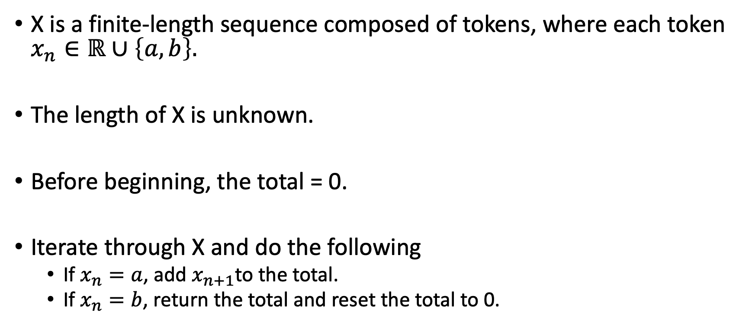
Here’s a problem. What can learn to do it?
X is a finite-length sequence composed of tokens, where each token $x_{n}∈ℝ∪\left\{a,b\right\}.$
The length of X is unknown.
Before beginning, the total = 0.
Iterate through X and do the following
If $x_{n}=a$, add $x_{n+1}$to the total.
If $x_{n}=b$, return the total and reset the total to 0.

Slide 32
Let’s play
a, -1, a, 100, b
= 99
1, 3, -5, a, 5, -1, 8 , 2, 0, a, 9, b
= 14
1, 3, a, -5, 0, 0, 0, 0, a, 5, -1, 7 ,2, 0, a, 9, -12, b
= 9

Slide 33
Feed-forward: Fixed-length time window
If your network needs to connect information from outside the window, you lose.
a, -1, a, 100, b
1, 3, a, -5, 0, 0, 0, 0, a, 5, -1, 7 ,2, 0, a, 9, -12, b

Slide 34
RNN: exponentially decaying influence
If your network needs to connect information from a distant timestep, the influence of the earlier one tends to get lost
Why? Exponential decay.
-5 a 5 -1 8 a 9 b

Slide 35
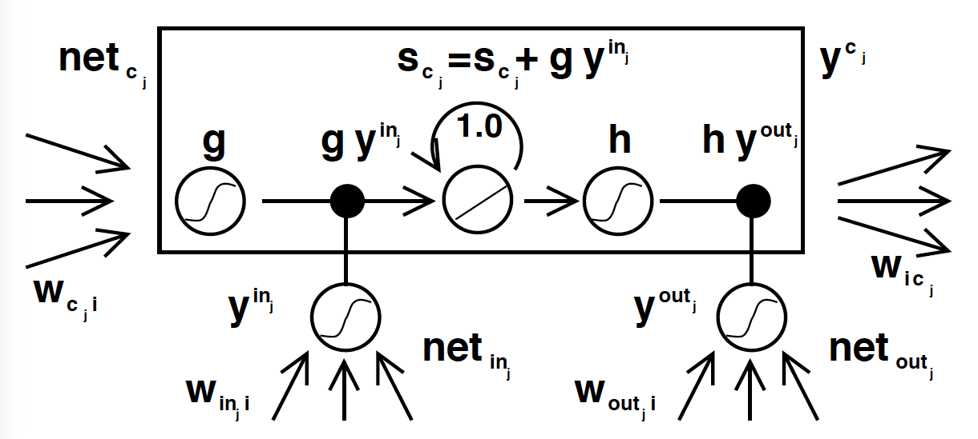
Long Short Term Memory Units (LSTMs)
Added a way of storing data over many time steps without decay
Let networks to handle problems with long term dependencies
Image from: Hochreiter, Sepp, and Jürgen Schmidhuber. "Long short-term memory." Neural computation 9.8 (1997): 1735-1780.

Slide 36
LSTM training
Error is propagated indefinitely through its memory cell, the constant error carousel (CEC)
Error flow back through the unit is truncated at the incoming weights.
Image from: Hochreiter, Sepp, and Jürgen Schmidhuber. "Long short-term memory." Neural computation 9.8 (1997): 1735-1780.

Slide 37
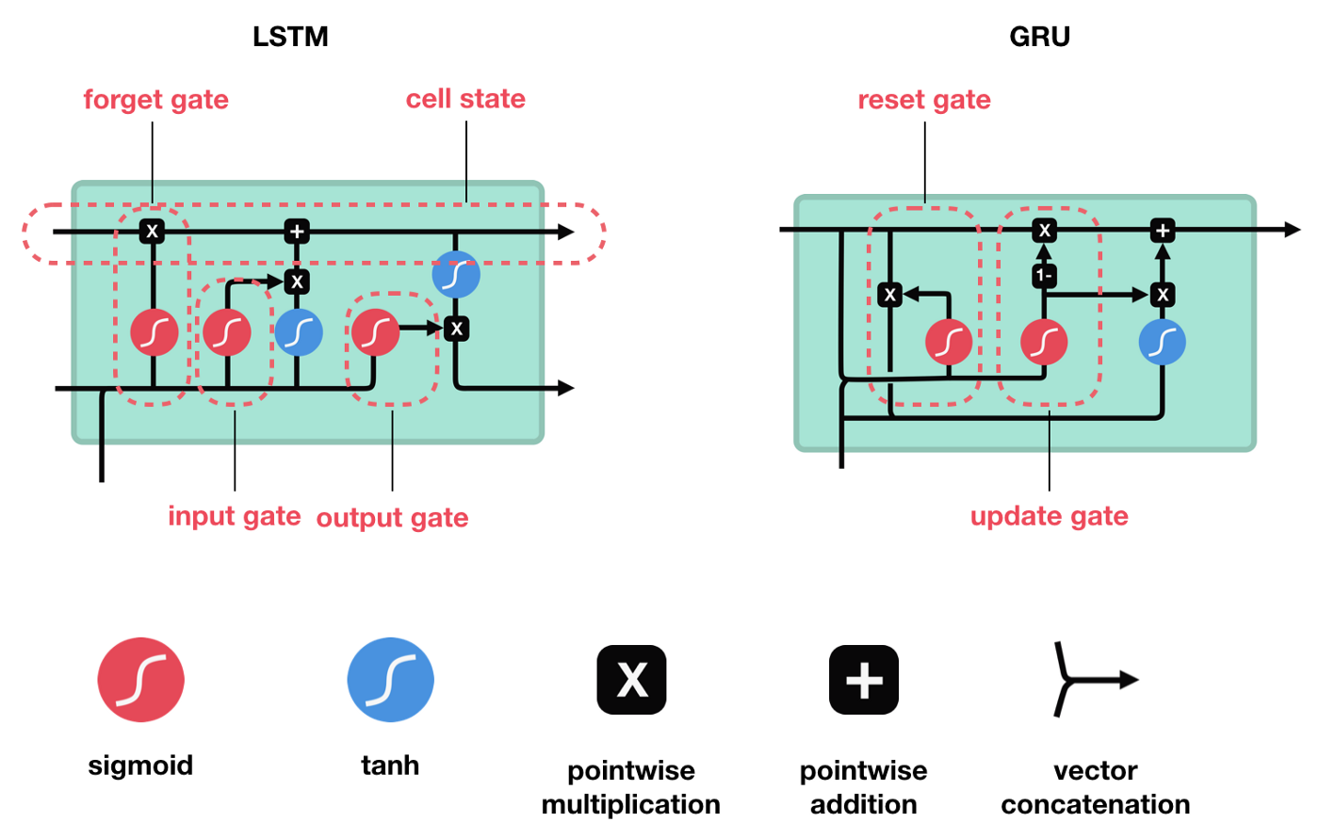
An easy-to-follow-visual of a modern LSTM
Forget gates introduced in: Gers, F.A. et al (1999). "Learning to forget: Continual prediction with LSTM". 9th International Conference on Artificial Neural Networks: 1999
Cell state from
prev. time step
Cell state at this timestep
Hidden state input
from other LSTM cells
Output
Network
input
Amazing gifs from Michael Phi’s https://towardsdatascience.com/illustrated-guide-to-lstms-and-gru-s-a-step-by-step-explanation-44e9eb85bf21

Slide 38
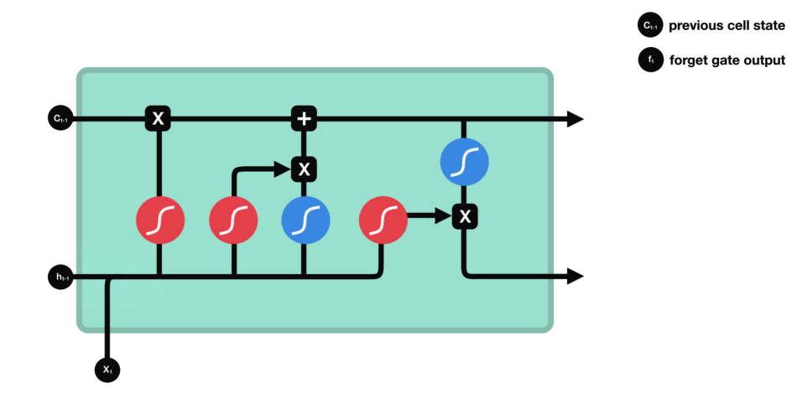
Forget Gate
Hidden state passed in from other cells
New input vector
Amazing gifs from Michael Phi’s https://towardsdatascience.com/illustrated-guide-to-lstms-and-gru-s-a-step-by-step-explanation-44e9eb85bf21

Slide 39
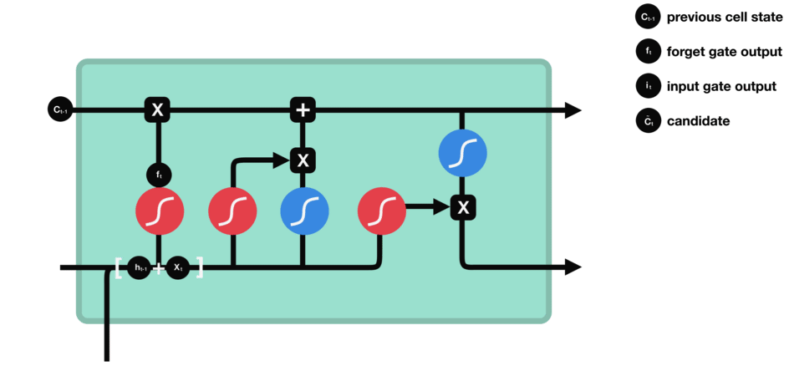
Input Gate
Amazing gifs from Michael Phi’s https://towardsdatascience.com/illustrated-guide-to-lstms-and-gru-s-a-step-by-step-explanation-44e9eb85bf21

Slide 40
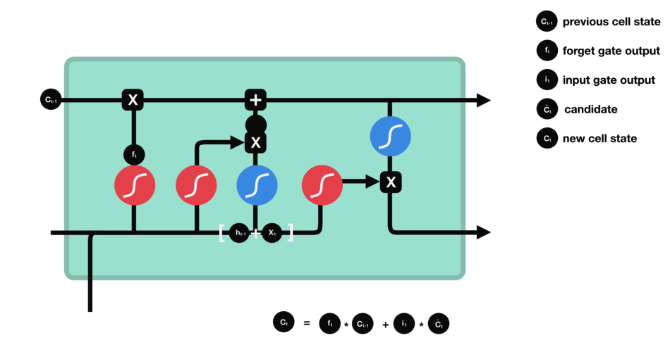
Cell State
Amazing gifs from Michael Phi’s https://towardsdatascience.com/illustrated-guide-to-lstms-and-gru-s-a-step-by-step-explanation-44e9eb85bf21

Slide 41

Output Gate
Amazing gifs from Michael Phi’s https://towardsdatascience.com/illustrated-guide-to-lstms-and-gru-s-a-step-by-step-explanation-44e9eb85bf21

Slide 42
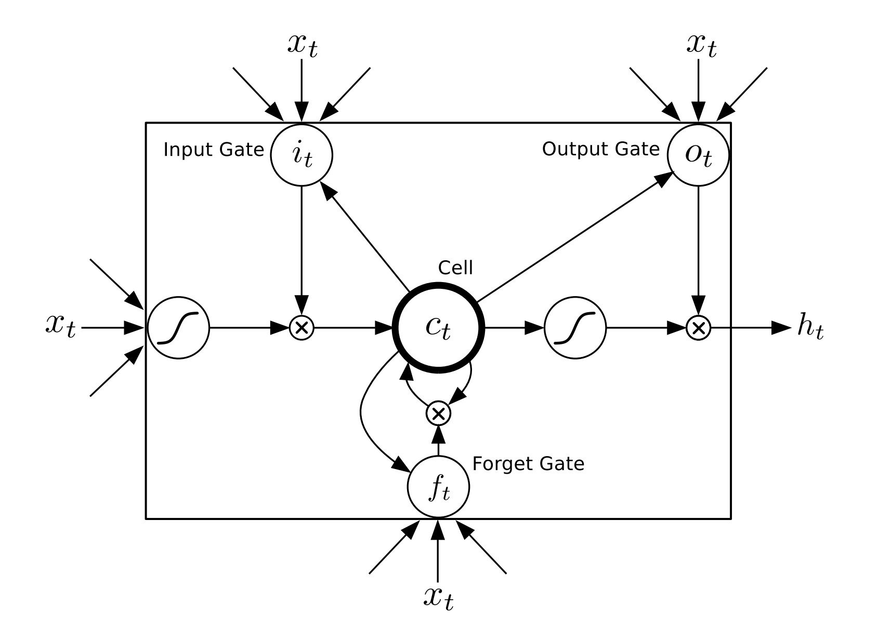
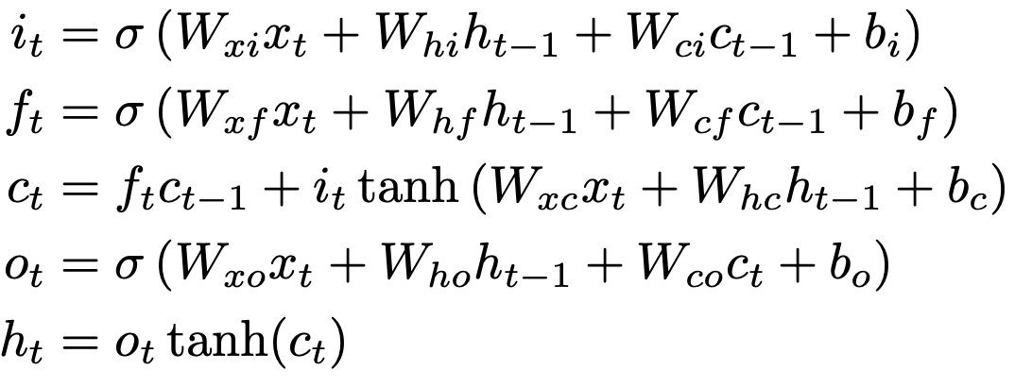
The math of the modern LSTM
Image adapted from Graves, Alex. "Generating sequences with recurrent neural networks." arXiv preprint arXiv:1308.0850 (2013).
Forget gates introduced in: Gers, F.A. et al (1999). "Learning to forget: Continual prediction with LSTM". 9th International Conference on Artificial Neural Networks: 1999

Slide 43
How many weights for a single LSTM unit?
Input gate
forget gate
memory
output gate
final output
$$number of weights=4\left|x\right|+4\left|h\right|+3+4$$

Slide 44
How many weights for this network?
Input: 50,000 word vocabulary, 4 LSTM layers of 100 cells per layer
Compare that to a vanilla RNN with the same number of layers and vocabulary size….
Can we shrink closer to a vanilla RNN but keep advantages of an LSTM?

Slide 45
GRU: A simplified LSTM
Images from Michael Phi’s https://towardsdatascience.com/illustrated-guide-to-lstms-and-gru-s-a-step-by-step-explanation-44e9eb85bf21

Slide 46
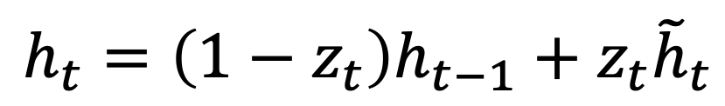
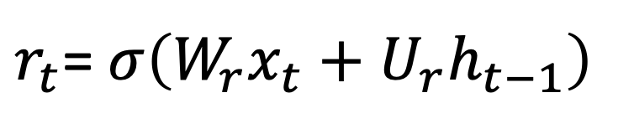
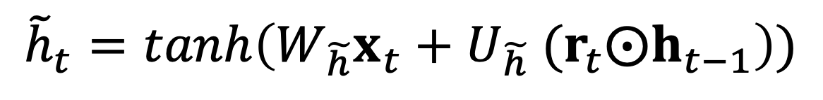
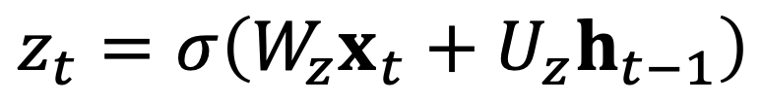
GRU: The Math
A linear interpolation between previous output and candidate output
Final output
$$h_{t}=\left(1−z_{t}\right)h_{t−1}+z_{t}{\tilde{h}}_{t}$$
Determines how much to make the output be influenced by the previous hidden state vs the current input.
$$z_{t}=σ\left(W_{z}x_{t}+U_{z}h_{t−1}\right)$$
Vector of all reset gates in the hidden layer
Update gate
$${\tilde{h}}_{t}=tanh\left(W_{\tilde{h}}x_{t}+U_{\tilde{h}} ({r_{t}⨀h}_{t−1}\right))$$
Candidate output
Determines how hard to reset this unit’s output
Vector of all outputs in the hidden layer
Reset gate
$r_{t}$= $σ\left(W_{r}x_{t}+U_{r}h_{t−1}\right)$
Math based on: Chung, Junyoung, et al. "Empirical evaluation of gated recurrent neural networks on sequence modeling." arXiv preprint arXiv:1412.3555 (2014)

Slide 47
LSTM/GRU Plusses and Minuses
Lets networks handle problems with long term dependencies
This lets LSTMs (or GRU) solve problems simple recurrent architectures cannot
Still has trouble with XOR (time-delayed XOR where you XOR two inputs that are an unknown number of time steps apart)
Lots of extra weights compared to regular cells
Long and slow to train
Not easy to inspect networks to understand them

